Slide 1
Automated Generation of Excel Spreadsheets: Integrating R and VBA for Enhanced Efficiency
Jundong Ma
2025.03.28

Slide 2
agenda
Story of Development
R Package: OPENXLSX2
VBA
Automation Cases
QA

Slide 3

Story of Development
Origin of the Story

Slide 4
Story of Development
Challenges Encountered
Continuous template updates
Format adjustments: colors, column widths, Freeze Panes…
Add Title, Notes, Spanning headers
Cover page design
Add study information
Add links to each sheet
Filter by sites or subjects
Count records

Slide 5
Story of Development
Problem-Solving
Continuous template updates
Template control data
Format adjustments: colors, column widths, and conditional formatting
Template control format
Add a column to track data changes
Use Key Variables or RECORDID
Cover page design
VBA to extract links
Filter by sites or subjects
VBA to filter and count

Slide 6
OPENXLSX2
Introduction
This package builds upon the foundation of openxlsx, aiming to serve as its successor.
Authored and maintained by Dr. Jan Marvin Garbuszus, who also maintains openxlsx, this package has been extensively rewritten to leverage modern technologies such as pugixml and R6. The result is a fresh, user-friendly R package designed to simplify and enhance the handling of xlsx files.
In my opinion, it stands out as the Best R Package for working with xlsx files!

Slide 7
OPENXLSX2
Functions
Load Workbook： wb_load("your_file.xlsx")
Create Workbook： wb_workbook()
Add a sheet： wb_add_worksheet(wb, sheet = "SheetName")
Add data： wb_add_data(wb, sheet = "SheetName", x = your_data)
Read Data： wb_to_df(wb, sheet = "SheetName")
Save Workbook： wb_save(wb, file = "output.xlsx")

Slide 8




OPENXLSX2
R6: Use of chains
Four Syntaxes, Identical Functionality:

Slide 9
VBA
Run R in VBA
Function Run_R_Script(sRApplicationPath As String, _
sRFilePath As String, _
Optional iStyle As Integer = 0, _
Optional bWaitTillComplete As Boolean = True) As Integer
Dim sPath As String
Dim shell As Object
Set shell = VBA.CreateObject("WScript.Shell")
wsPath = Application.ActiveWorkbook.FullName()
wsPath = """" & wsPath & """"
sRApplicationPath = """" & sRApplicationPath & """"
sRFilePath = """" & sRFilePath & """"
sPath = sRApplicationPath
sPath = sPath & " "
sPath = sPath & sRFilePath
sPath = sPath & " "
sPath = sPath & wsPath
Run_R_Script = shell.Run(sPath, iStyle, bWaitTillComplete)
End Function

Slide 10
VBA
Filter by Subject
Sub Subject_Click()
Call Select_click("D11", 3)
t = ThisWorkbook.Worksheets.Count
For i = 2 To t
Set rngFilter = ThisWorkbook.Worksheets(i).Range("$A:$Z")
Set GetLasRangeCol = rngFilter.Columns(3).Cells
j = i + 15
ThisWorkbook.Worksheets(1).Range("O" & j) = Application.WorksheetFunction.CountIf(GetLasRangeCol, Range("D11"))
Next
End Sub

Slide 11
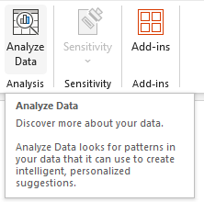
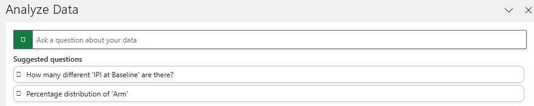
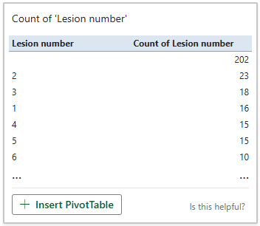
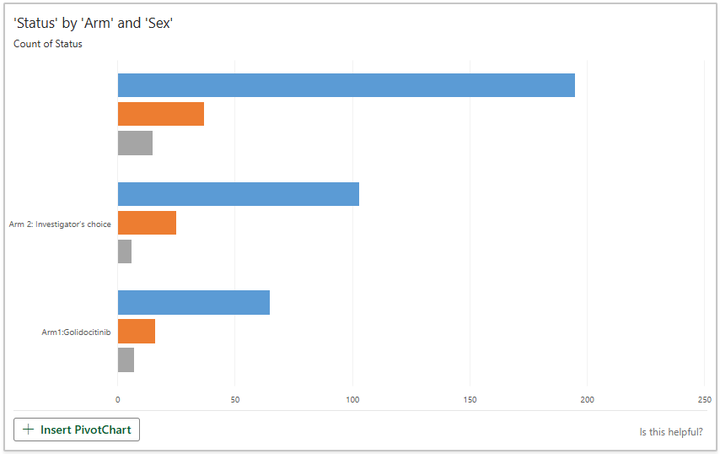
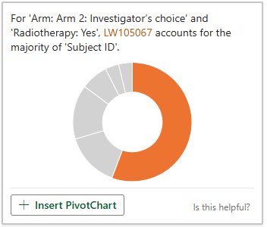
Analyze Data

Slide 12
Automation Cases
MDR Listings & SEND Review
MDR Listings: Generate Template according to ALS
SEND Review: Generate Template according to SEND package

Slide 13
Summary
OPENXLSX2
Powerful XML library
Extensive functionality
MIT license
vbA
Integration with Microsoft Office
Customized Automation of Repetitive Tasks
Access to Windows API
Fast for XLSX

Slide 14



THANK YOU!
jundong.ma@dizalpharma.com

